Slide 1




Dynamic Scheduling of Network Updates
Xin Jin
Hongqiang Harry Liu, Rohan Gandhi, Srikanth Kandula, Ratul Mahajan,
Ming Zhang, Jennifer Rexford, Roger Wattenhofer

Slide 2
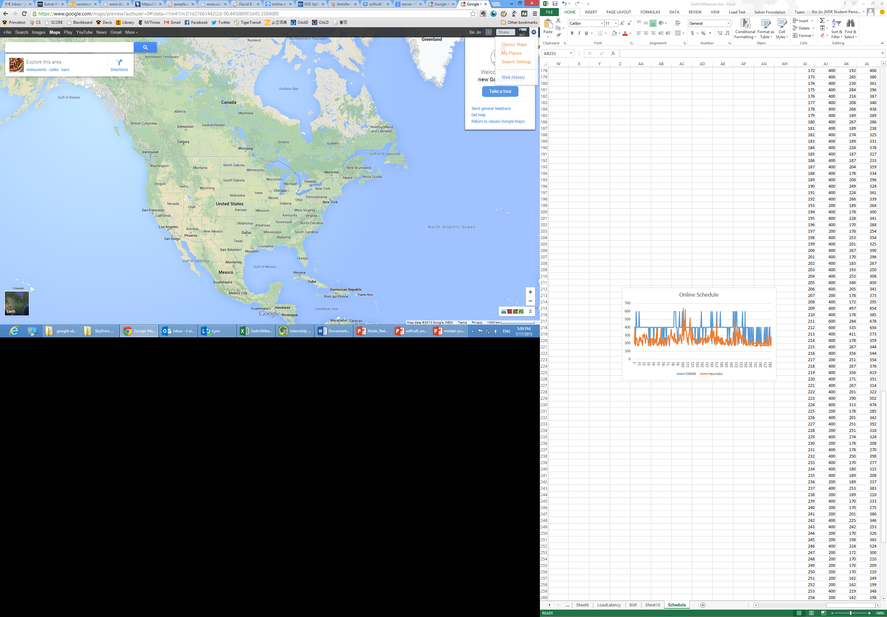
SDN: Paradigm Shift in Networking
Direct, centralized updates of forwarding rules in switches
Controller
Many benefits
Traffic engineering [B4, SWAN]
Flow scheduling [Hedera, DevoFlow]
Access control [Ethane, vCRIB]
Device power management [ElasticTree]

Slide 3

Network Update is Challenging
Requirement 1: fast
The agility of control loop
Requirement 2: consistent
No congestion, no blackhole, no loop, etc.
Controller
Network

Slide 4
What is Consistent Network Update
A
B
C
A
B
C
F2: 5
F3: 10
F2: 5
F3: 10
F1: 5
F1: 5
F4: 5
D
E
D
E
F4: 5
Current State
Target State

Slide 5
What is Consistent Network Update
A
B
C
A
B
C
F2: 5
F3: 10
F2: 5
F3: 10
F1: 5
F1: 5
F4: 5
D
E
D
E
F4: 5
Current State
Target State
A
B
C
F2: 5
F3: 10
F1: 5
F4: 5
D
E
Transient State
Asynchronous updates can cause congestion
Need to carefully order update operations

Slide 6
Existing Solutions are Slow
Existing solutions are static [ConsistentUpdate’12, SWAN’13, zUpdate’13]
Pre-compute an order for update operations
Static
Plan A
F3
F2
F4
F1
A
B
C
A
B
C
F2: 5
F3: 10
F2: 5
F3: 10
F1: 5
F1: 5
F4: 5
D
E
D
E
F4: 5
Current State
Target State

Slide 7
Existing Solutions are Slow
Existing solutions are static [ConsistentUpdate’12, SWAN’13, zUpdate’13]
Pre-compute an order for update operations
Downside: Do not adapt to runtime conditions
Slow in face of highly variable operation completion time
Static
Plan A
F3
F2
F4
F1

Slide 8
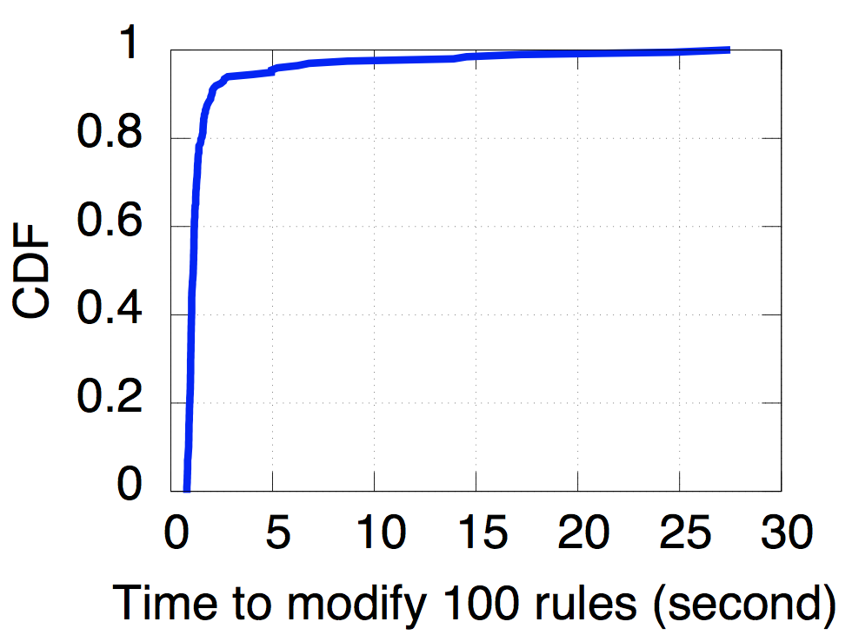
Operation Completion Times are Highly Variable
Measurement on commodity switches
>10x

Slide 9
Operation Completion Times are Highly Variable
Measurement on commodity switches
Contributing factors
Control-plane load
Number of rules
Priority of rules
Type of operations (insert vs. modify)

Slide 10

Static Schedules can be Slow
F3
F2
F1
F1
Static
Plan A
F2
F2
F4
F1
F3
F3
F4
F4
1
2
3
4
5
Time
1
2
3
4
5
Time
F1
F1
F3
F2
F1
F2
F2
Static
Plan B
F3
F3
F4
F4
F4
1
2
3
4
5
Time
1
2
3
4
5
Time
No static schedule is a clear winner under all conditions!
A
B
C
A
B
C
F2: 5
F3: 10
F2: 5
F3: 10
F1: 5
F1: 5
F4: 5
D
E
D
E
F4: 5
Current State
Target State

Slide 11
Dynamic Schedules are Adaptive and Fast
Static
Plan A
F3
F2
F4
F1
F3
F2
Dynamic
Plan
F1
F4
F3
F2
F1
Adapts to actual conditions!
Static
Plan B
F4
No static schedule is a clear winner under all conditions!
A
B
C
A
B
C
F2: 5
F3: 10
F2: 5
F3: 10
F1: 5
F1: 5
F4: 5
D
E
D
E
F4: 5
Current State
Target State

Slide 12
Challenges of Dynamic Update Scheduling
Exponential number of orderings
Cannot completely avoid planning
F5: 10
F5: 10
A
B
C
A
B
C
F2: 5
F2: 5
F1: 5
F1: 5
F3: 5
F4: 5
F4: 5
D
E
D
F3: 5
E
Current State
Target State

Slide 13
Challenges of Dynamic Update Scheduling
Exponential number of orderings
Cannot completely avoid planning
F5: 10
F5: 10
A
B
C
A
B
C
F2: 5
F2: 5
F1: 5
F1: 5
F3: 5
F4: 5
F4: 5
D
E
D
F3: 5
E
Current State
Target State
F2
Deadlock

Slide 14
Challenges of Dynamic Update Scheduling
Exponential number of orderings
Cannot completely avoid planning
F5: 10
F5: 10
A
B
C
A
B
C
F1: 5
F2: 5
F2: 5
F1: 5
F3: 5
F4: 5
D
F4: 5
D
E
F3: 5
E
Current State
Target State
F1

Slide 15
Challenges of Dynamic Update Scheduling
Exponential number of orderings
Cannot completely avoid planning
F5: 10
F5: 10
A
B
C
A
B
C
F2: 5
F2: 5
F1: 5
F1: 5
D
E
F4: 5
D
E
F4: 5
F3: 5
F3: 5
Current State
Target State
F1
F3

Slide 16
Challenges of Dynamic Update Scheduling
Exponential number of orderings
Cannot completely avoid planning
F5: 10
F5: 10
A
B
C
A
B
C
F2: 5
F2: 5
F1: 5
F1: 5
D
E
F4: 5
D
E
F4: 5
F3: 5
F3: 5
Current State
Target State
F1
F3
F2
Consistent update plan

Slide 17
Dionysus Pipeline
Current
State
Target
State
Consistency
Property
Dependency Graph Generator
Encode valid orderings
Update Scheduler
Determine a fast order
Network

Slide 18
Dependency Graph Generation
F5: 10
F5: 10
A
B
C
A
B
C
F2: 5
F2: 5
F1: 5
F3: 5
F1: 5
D
E
F4: 5
D
E
F4: 5
F3: 5
Current State
Target State
Dependency Graph Elements
Operation node
Node
Resource node (link capacity, switch table size)
Path node
Edge
Dependencies between nodes

Slide 19
Dependency Graph Generation
F5: 10
F5: 10
A
B
C
A
B
C
F2: 5
F2: 5
F1: 5
F3: 5
F1: 5
D
E
F4: 5
D
E
F4: 5
F3: 5
Current State
Target State
Move
F2
Move
F3
Move
F1

Slide 20
Dependency Graph Generation
F5: 10
F5: 10
A
B
C
A
B
C
F2: 5
F2: 5
F1: 5
F3: 5
F1: 5
D
E
F4: 5
D
E
F4: 5
F3: 5
Current State
Target State
Move
F2
A-E: 5
Move
F3
Move
F1

Slide 21
Dependency Graph Generation
F5: 10
F5: 10
A
B
C
A
B
C
F2: 5
F2: 5
F1: 5
F3: 5
F1: 5
D
E
F4: 5
D
E
F4: 5
F3: 5
Current State
Target State
Move
F2
A-E: 5
5
Move
F3
Move
F1

Slide 22
Dependency Graph Generation
F5: 10
F5: 10
A
B
C
A
B
C
F2: 5
F2: 5
F1: 5
F3: 5
F1: 5
D
E
F4: 5
D
E
F4: 5
F3: 5
Current State
Target State
5
Move
F2
A-E: 5
5
Move
F3
Move
F1

Slide 23
Dependency Graph Generation
F5: 10
F5: 10
A
B
C
A
B
C
F2: 5
F2: 5
F1: 5
F3: 5
F1: 5
D
E
F4: 5
D
E
F4: 5
F3: 5
Current State
Target State
5
Move
F2
A-E: 5
5
5
Move
F3
Move
F1

Slide 24
Dependency Graph Generation
F5: 10
F5: 10
A
B
C
A
B
C
F2: 5
F2: 5
F1: 5
F3: 5
F1: 5
D
E
F4: 5
D
E
F4: 5
F3: 5
Current State
Target State
5
Move
F2
A-E: 5
5
5
Move
F3
Move
F1
5
5
D-E: 0

Slide 25
Dependency Graph Generation
Supported scenarios
Tunnel-based forwarding: WANs
WCMP forwarding: data center networks
Supported consistency properties
Loop freedom
Blackhole freedom
Packet coherence
Congestion freedom
Check paper for details

Slide 26
Dionysus Pipeline
Current
State
Target
State
Consistency
Property
Dependency Graph Generator
Encode valid orderings
Update Scheduler
Determine a fast order
Network

Slide 27

Dionysus Scheduling
Scheduling as a resource allocation problem
5
Move
F2
A-E: 5
5
5
Move
F3
Move
F1
5
5
D-E: 0

Slide 28
Dionysus Scheduling
Scheduling as a resource allocation problem
Move
F2
A-E: 0
5
5
Move
F3
Move
F1
Deadlock!
5
5
D-E: 0

Slide 29
Dionysus Scheduling
Scheduling as a resource allocation problem
5
Move
F2
A-E: 0
5
Move
F3
Move
F1
5
5
D-E: 0

Slide 30
Dionysus Scheduling
Scheduling as a resource allocation problem
5
Move
F2
A-E: 0
5
Move
F3
5
D-E: 5

Slide 31
Dionysus Scheduling
Scheduling as a resource allocation problem
5
Move
F2
A-E: 0
5
Move
F3

Slide 32
Dionysus Scheduling
Scheduling as a resource allocation problem
5
Move
F2
A-E: 5

Slide 33
Dionysus Scheduling
Scheduling as a resource allocation problem
Move
F2
Done!

Slide 34
Dionysus Scheduling
Scheduling as a resource allocation problem
NP-complete problems under link capacity and switch table size constraints
Approach
DAG: always feasible, critical-path scheduling
General case: covert to a virtual DAG
Rate limit flows to resolve deadlocks

Slide 35
Critical-Path Scheduling
Calculate critical-path length (CPL) for each node
Extension: assign larger weight to operation nodes if we know in advance the switch is slow
Resource allocated to operation nodes with larger CPLs
Move
F1
CPL=3
5
A-B:5
CPL=2
5
5
CPL=1
Move
F2
Move
F3
CPL=2
5
C-D:0
CPL=1
5
Move
F4
CPL=1

Slide 36
Critical-Path Scheduling
Calculate critical-path length (CPL) for each node
Extension: assign larger weight to operation nodes if we know in advance the switch is slow
Resource allocated to operation nodes with larger CPLs
Move
F1
CPL=3
5
A-B:0
CPL=2
5
CPL=1
Move
F2
Move
F3
CPL=2
5
C-D:0
CPL=1
5
Move
F4
CPL=1

Slide 37
Handling Cycles
5
Move
F2
Convert to virtual DAG
Consider each strongly connected component (SCC) as a virtual node
A-E: 5
5
5
Move
F3
Move
F1
5
5
D-E: 0
Critical-path scheduling on virtual DAG
Weight w_{i} of SCC: number of operation nodes
CPL=1
CPL=3
Move
F2
weight = 2
weight = 1

Slide 38
Handling Cycles
5
Move
F2
Convert to virtual DAG
Consider each strongly connected component (SCC) as a virtual node
A-E: 0
5
Move
F3
Move
F1
5
5
D-E: 0
Critical-path scheduling on virtual DAG
Weight w_{i} of SCC: number of operation nodes
CPL=1
CPL=3
Move
F2
weight = 2
weight = 1

Slide 39
Evaluation: Traffic Engineering
Not congestion-free
Congestion-free
Congestion-free

Slide 40
Evaluation: Traffic Engineering
Not congestion-free
Congestion-free
Congestion-free
Improve 50th percentile update speed by 80%
compared to static scheduling (SWAN), close to OneShot

Slide 41
Evaluation: Failure Recovery

Slide 42
Evaluation: Failure Recovery
Reduce 99th percentile link oversubscription by 40% compared to static scheduling (SWAN)
Improve 99th percentile update speed by 80% compared to static scheduling (SWAN)

Slide 43
Conclusion
Dionysus provides fast, consistent network updates through dynamic scheduling
Dependency graph: compactly encode orderings
Scheduling: dynamically schedule operations
Dionysus enables more agile SDN control loops

Slide 44

Thanks!

